Slide 1
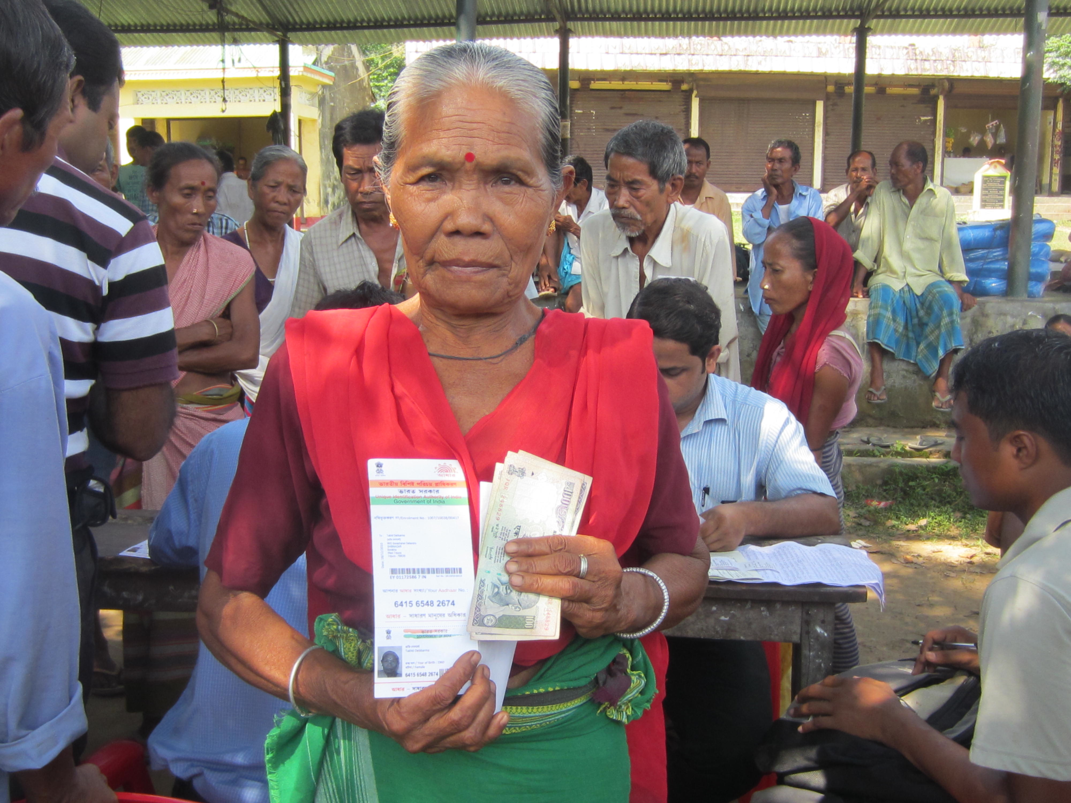
The transformatory potential of Aadhaar - Providing empowerment, choice and convenience
CUTS Thought Leadership Lecture
Jaipur
January 24th, 2013
Notes:
1

Slide 2
Where Are We?
Our lives are being digitized faster than ever
  2002: 125 years later mobile connections surpassed landline connections
  2010: 300 years later online ad revenue surpassed news paper ad revenue in US
  2012: 244 years later Britannica Encyclopedia go out of print
  Digital news, photos, music, video, sharing, networking, …
Devices are cheaper, smarter, versatile than ever
  iPod changed music industry, iPhone changed the way we interact with personal computing devices, iPad growth is huge!
  And Android based phones nearly 5x of all these!!!
* Sources: International Telecommunication Union, Kellog School of Management, News paper Association of America, Gartner, Apple, KPCB

Slide 3
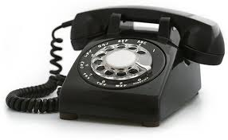

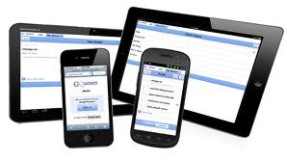
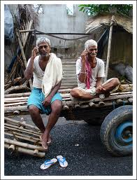
THEN…
NOW…
Long wait for connection
No Mobility
No/limited Access
Immediate connection
Anywhere
Access at fingertips

Slide 4

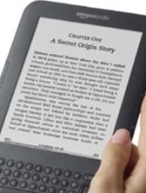


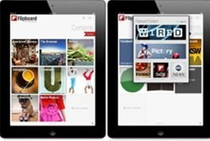

THEN…
NOW…
Limited access
Delayed
Global access
Instant

Slide 5
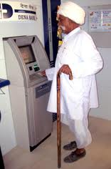
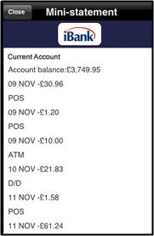
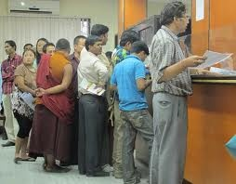
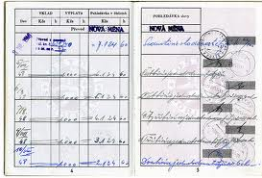
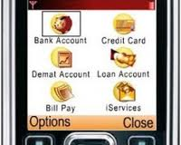
THEN…
NOW…
Branch based
Paper based
No convenience
Anywhere
Electronic
Anytime

Slide 6
UIDAI’s Mandate
To provide Unique ID Number to all Residents
  Enrolment is a one time process for the resident
  Establishes Uniqueness
Provide online, cost-effective, ubiquitous authentication services across country
  Authentication is transactional
  Establishes identity
  To be done at the time of availing a benefit

Slide 7
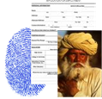
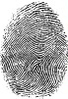

UIDAI issues unique IDs …
UID ⬄ Unique number ⬄ Random number
Name
Parents
Gender
DoB
PoB
Address
Basic demographic data and biometrics stored centrally
Standardized identity attributes
No duplicates(1:N check)
Flexibility to partners on Know Your Resident (KYR)+
UID = 1568 3647 6218
Central UID database
Notes:
In simple words, we will enroll everyone with basic identity attributes, ensure that there are no duplicates. We will not collect profiing attributes and we will not maintain transactional records.

Slide 8
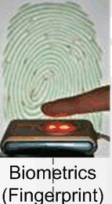
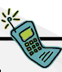

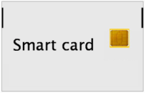
… and authenticate IDs online, real-time
Authentication - ‘Are you who you claim to be?’
UID = 1568 3647 6218
Central UID database
1:1 check, no ID fraud
Only YES/NO response, no details
Notes:
Our audacious goal is to provide ubiquitous on-line authentication. Authentication to us is simple: Are you who you claim to be? Answer is only yes or no. there is no invasion of privacy. No information is disclosed during authentication.
Mandate is simple. How do we achieve it?

Slide 9
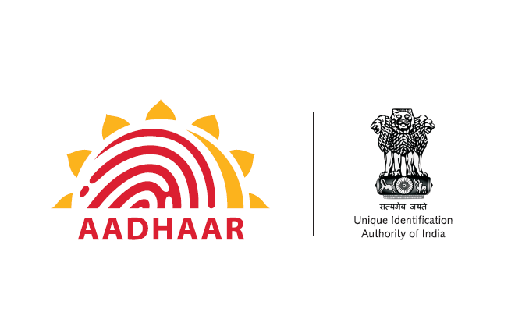
Where are we today…
Resident Digital Identity
Started issuing in Sept 2010
250 million Aadhaars issued so far
About 300 million residents enrolled
Target – 600 million by 2014

Slide 10
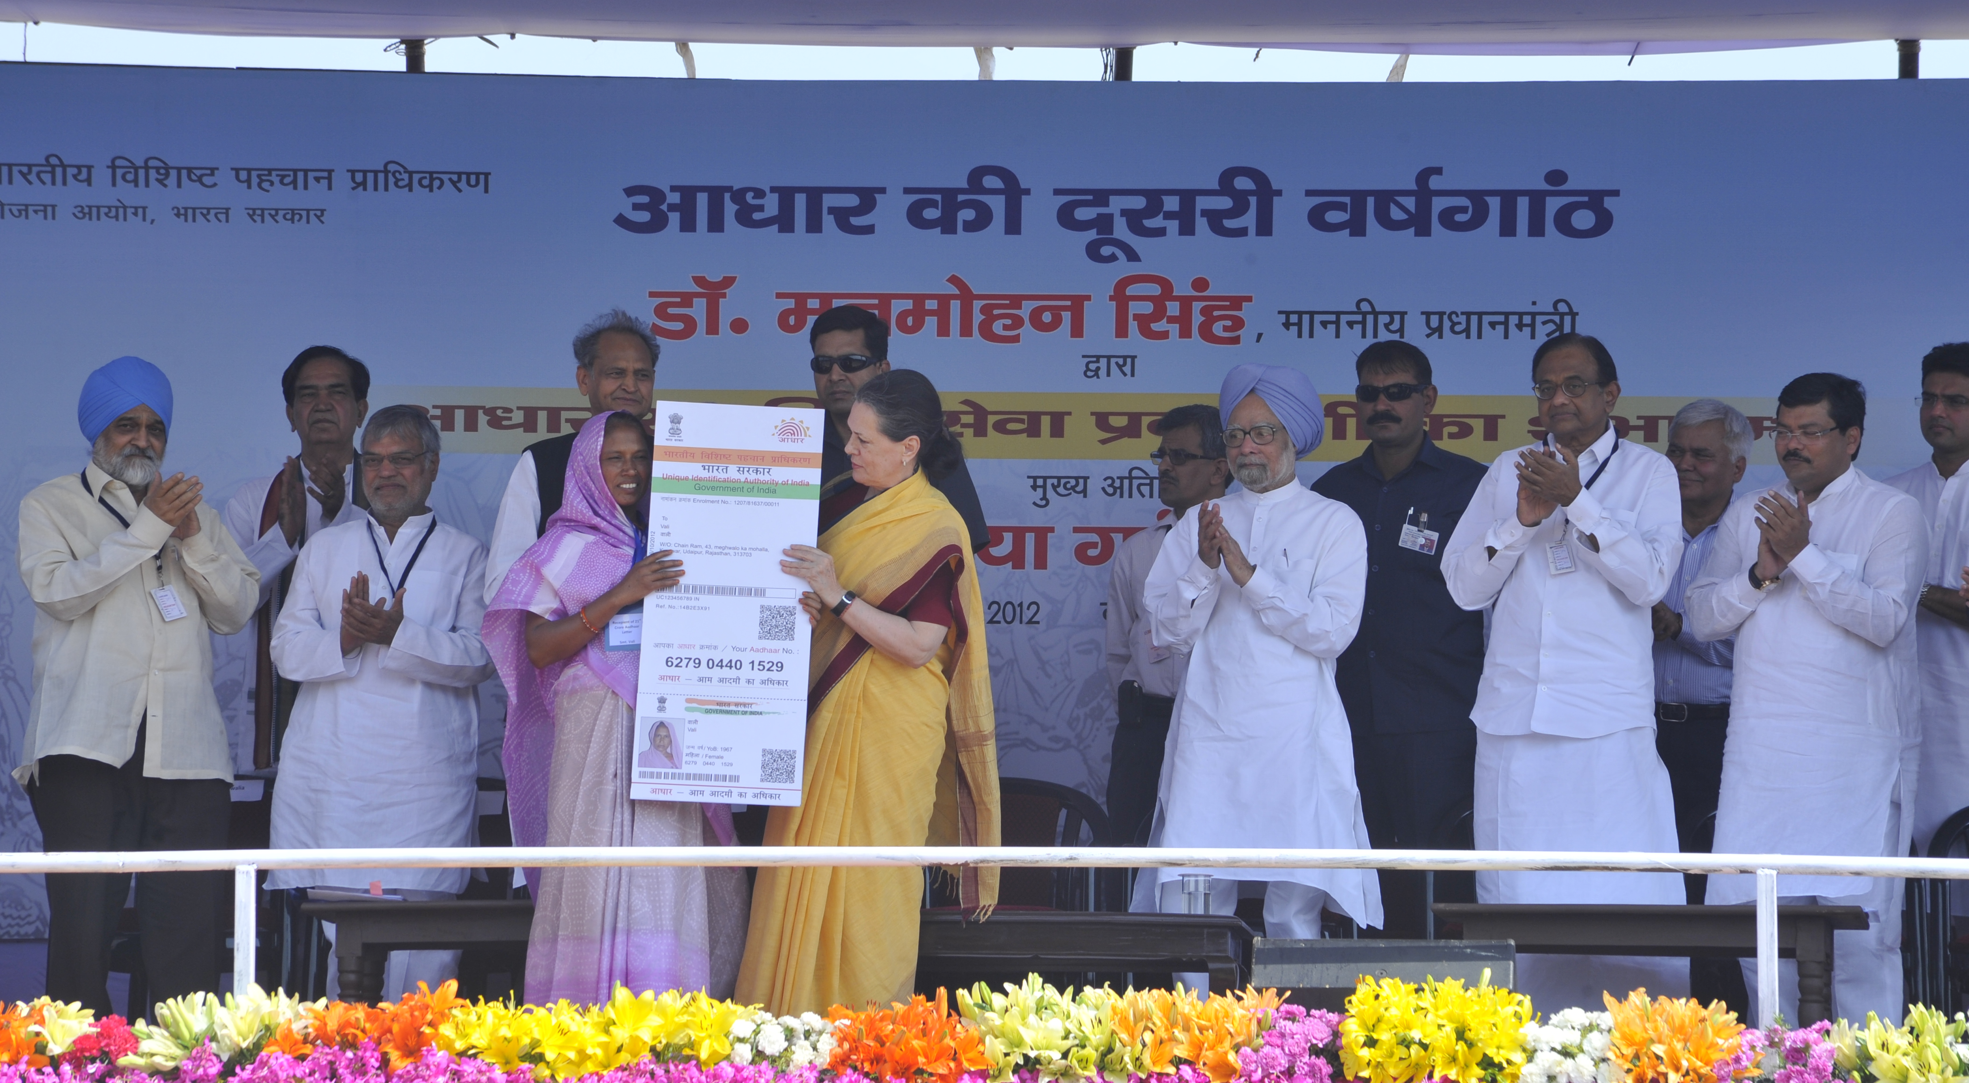
2nd anniversary launch and handing over of the 21st crore Aadhaar number was in Dudu in Rajasthan on October 20th 2012

Slide 11
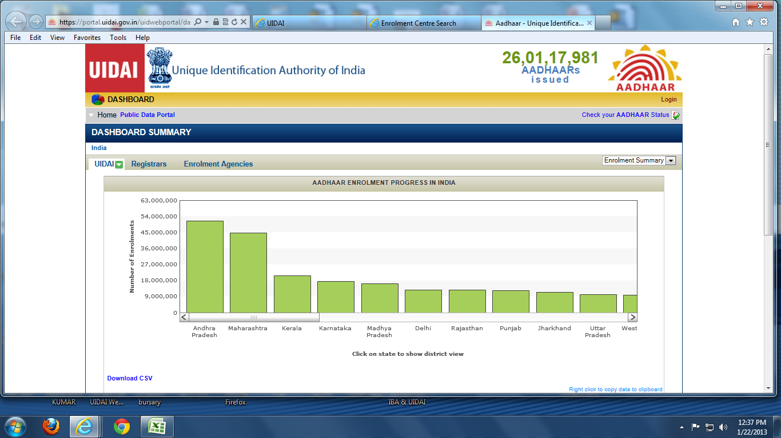
Status as on 22nd January 2013… 260 million Aadhaars generated

Slide 12
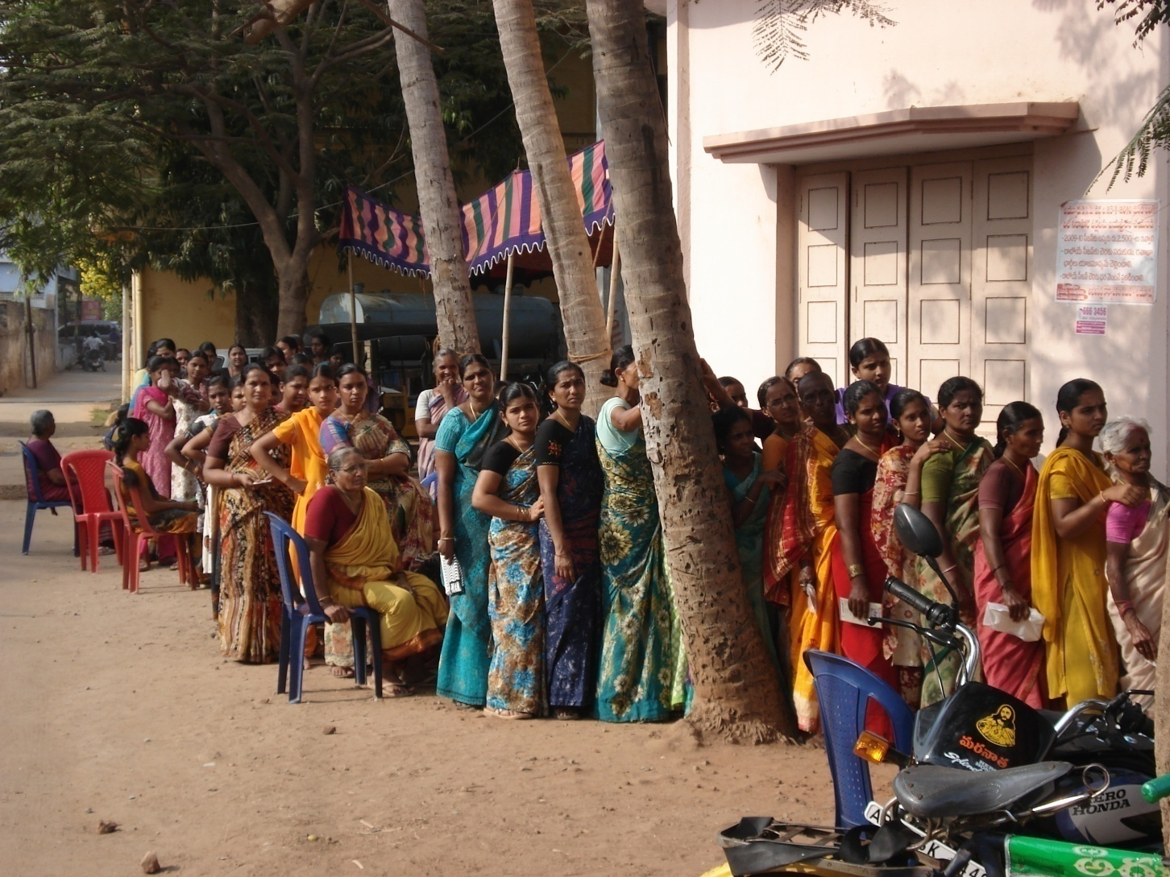
Enrolment centre, Andhra Pradesh

Slide 13
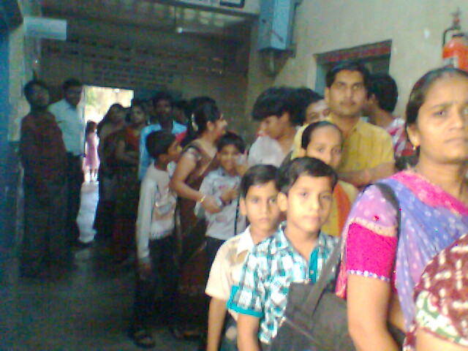
Enrolment Centre, Maharashtra

Slide 14
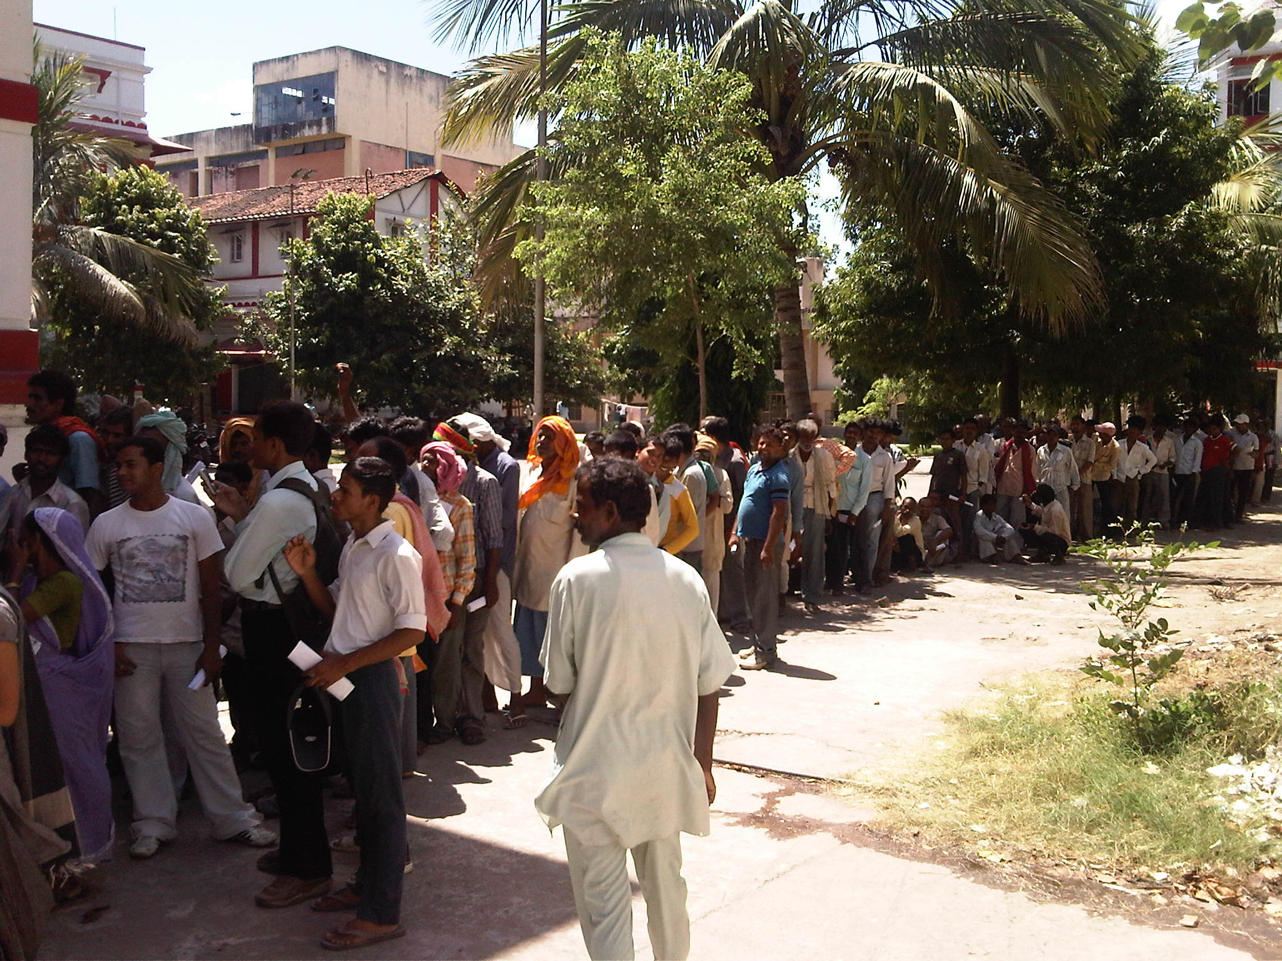
Enrolment centre in Jharkhand

Slide 15
Service Delivery potential due to Authentication
Transactions normally require verification of identity
Aadhaar online authentication will provide a common platform which can be used across all transactions and other applications.
Entitlements should reach the intended beneficiary – non-transferability can be ensured
This can be effectively done by authentication at the point of service delivery
Many domains will be able to use as a proof of presence for the beneficiary : Attendance, proxies in the examinations

Slide 16
Aadhaar e-KYC Service
The Aadhaar e-KYC service instantaneously provides KYC data (name, address, date of birth, gender, photograph) of the beneficiary upon successful Aadhaar authentication.
The e-KYC data can be used for seeding of Aadhaar in the Government databases.
The e-KYC data can be used by Banks and India Post for opening instant accounts or linking existing accounts.
The e-KYC platform can scale up to lakhs of transactions on a daily basis
Notes:
Ram goes to withdraw cash
Explain MicroATM
TransferMoney txn, with fingerprint to merchant bank
NPCI authenticates the resident using UID, gets bank account using the ID mapper
Executes the debit and credit transaction
Sends SMS to resident and BC about debit and credit respectively
BC gives resident the cash.
Any Bank, Any Mobile, Any BC – no hardwiring of components or vendors – thru UID higher level of abstraction
MicroATM can perform all txns - Can perform deposits and C2C transfers as well.

Slide 17
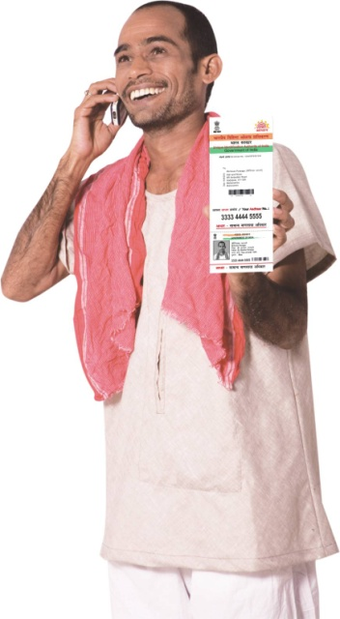
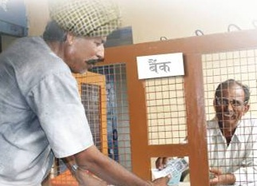
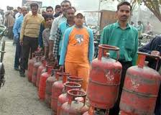

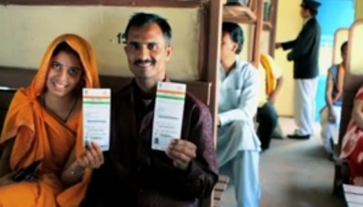
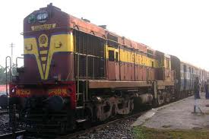
Empowerment –
Aadhaar as common e-KYC platform
1
Mobile connections
2
Bank A/Cs, Insurance, etc.
3
LPG Connections
?
State Government Services
4
Train Travel
6
5
Your application
Enhances access to services by reducing hassle

Slide 18









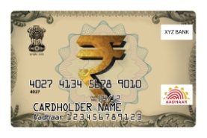








Instant cash transfer – Aadhaar as a payment address
Any resident with Aadhaar can automatically receive money.
If a resident already has an Aadhaar-linked account, the money is transferred into that account.
If the resident does not have an account, an Instant Account is created upon receipt of funds.
State Governments
Government of India
+
+
Any Accredited Bank
Aadhaar Payments Bridge
Existing Account or
Instant
Account!
Aadhaar | Account
8384 8239 5837 | 27390239
4390 9203 9593 | 397802232
Employers
Governments, organizations, and individuals can transfer money to residents by specifying the Aadhaar number and amount.
Family, Friends

Slide 19
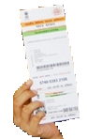
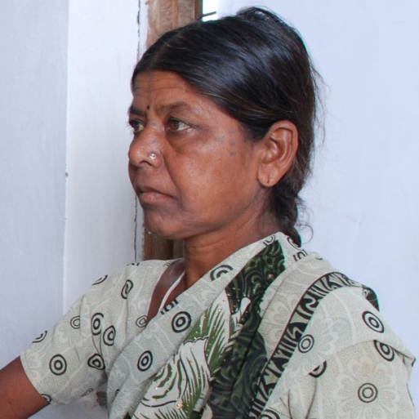

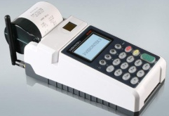
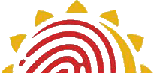
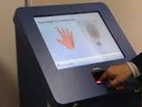
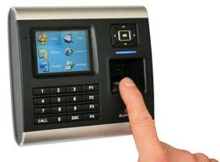
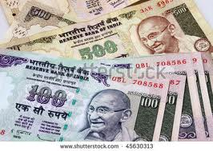

Convenience and Choice
Pension
Bank
Radha 111122223333
xxxcccc
----- -----
1111 2222 3333
2. Aadhaar as KYC to open bank account
MGNREGA
Radha 111122223333
xxxxx
Aadhaar Payment Bridge
yyyyy
----- -----
Scholarship
3. Aadhaar as a payment address
1111 2222 3333
Radha 111122223333
xxxxx
----- -----
1. Aadhaar to
de-duplicate databases
4. Withdraw from any MicroATM at the doorstep
5. End to end auditability and transparency

Slide 20
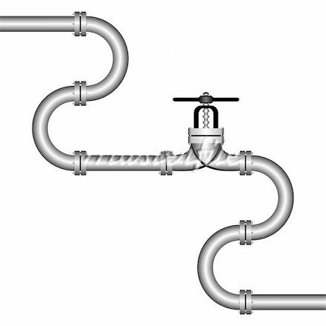
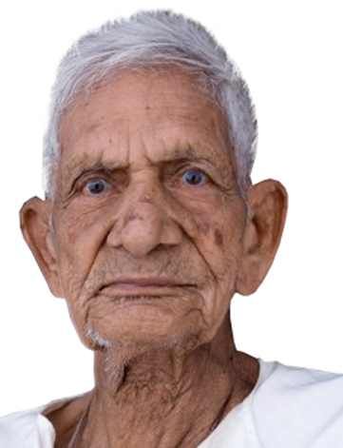
End-to-End Traceability through
Aadhaar Enabled Direct Benefit Transfer
1111 2222 3333
Government ‘puts in’ money using an Aadhaar
1111 2222 3333
Beneficiary ‘takes out’ his money using same Aadhaar and his biometric
Convenience for the beneficiary

Slide 21
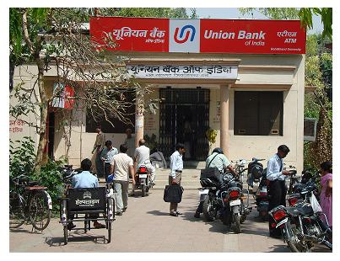
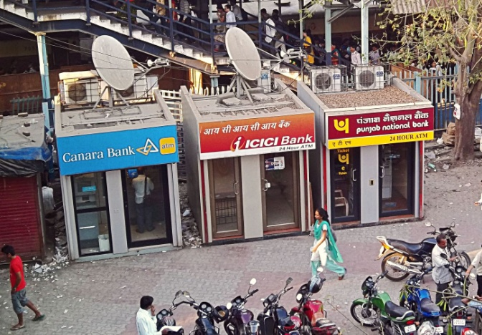
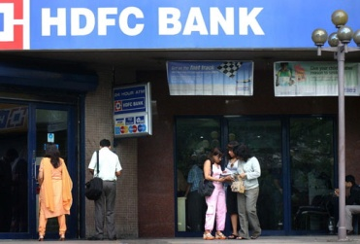
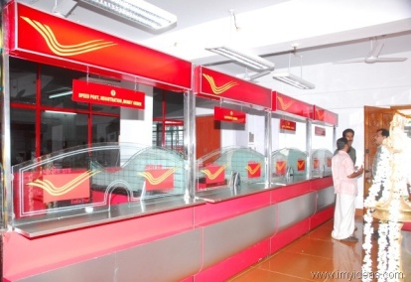
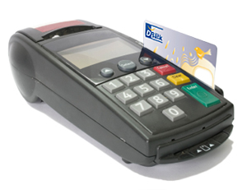
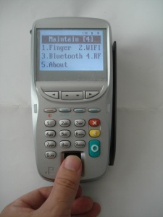
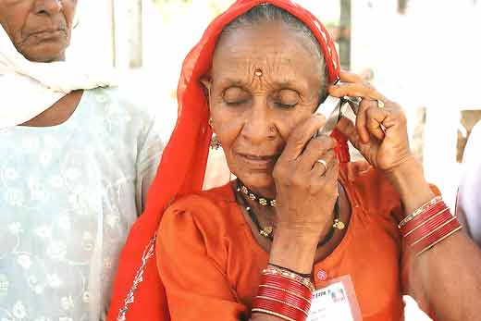
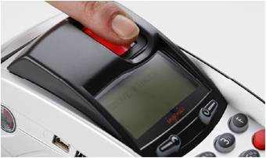

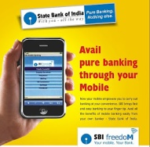

Access to a large number of Customer Service Points
Bank branches and Post Offices 2,50,000 today
ATMs
1,00,000 today
POS terminals
5,00,000 today
Aadhaar-enabled MicroATMs
10,00,000 by 2014
Banking through Mobile phones, Internet
Any where, any time access
60,00,00,000 today

Slide 22
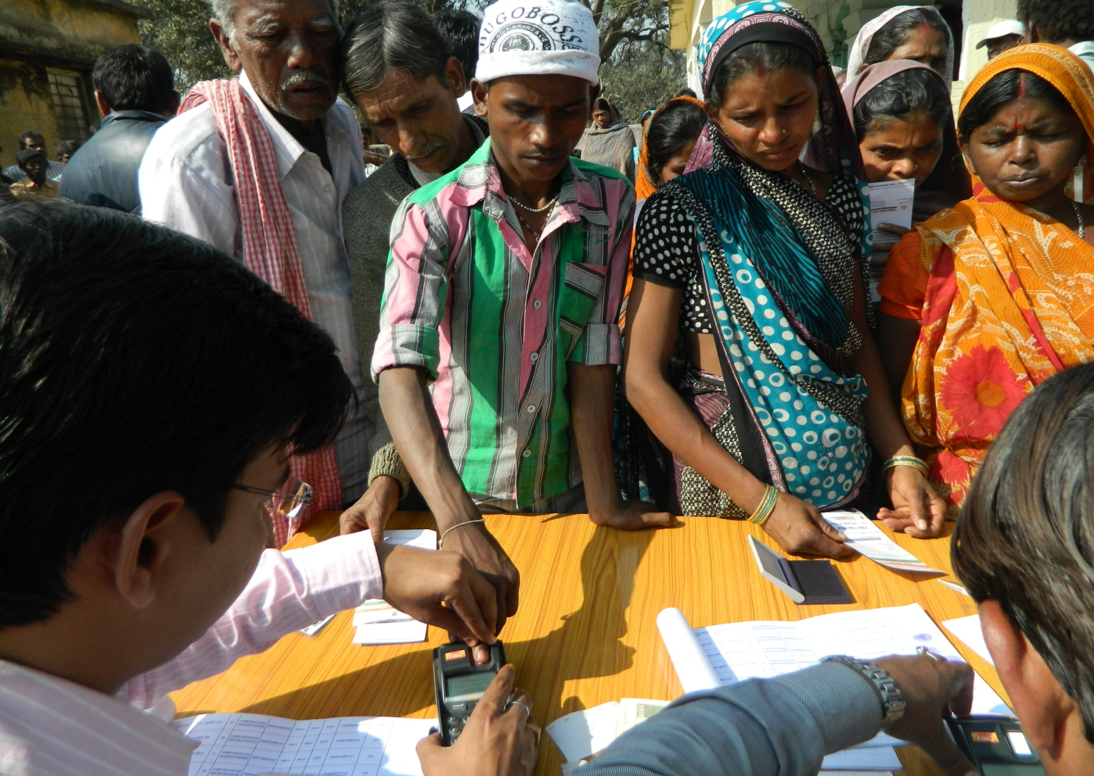
MNREGA payments through Micro-ATM in Jharkhand

Slide 23
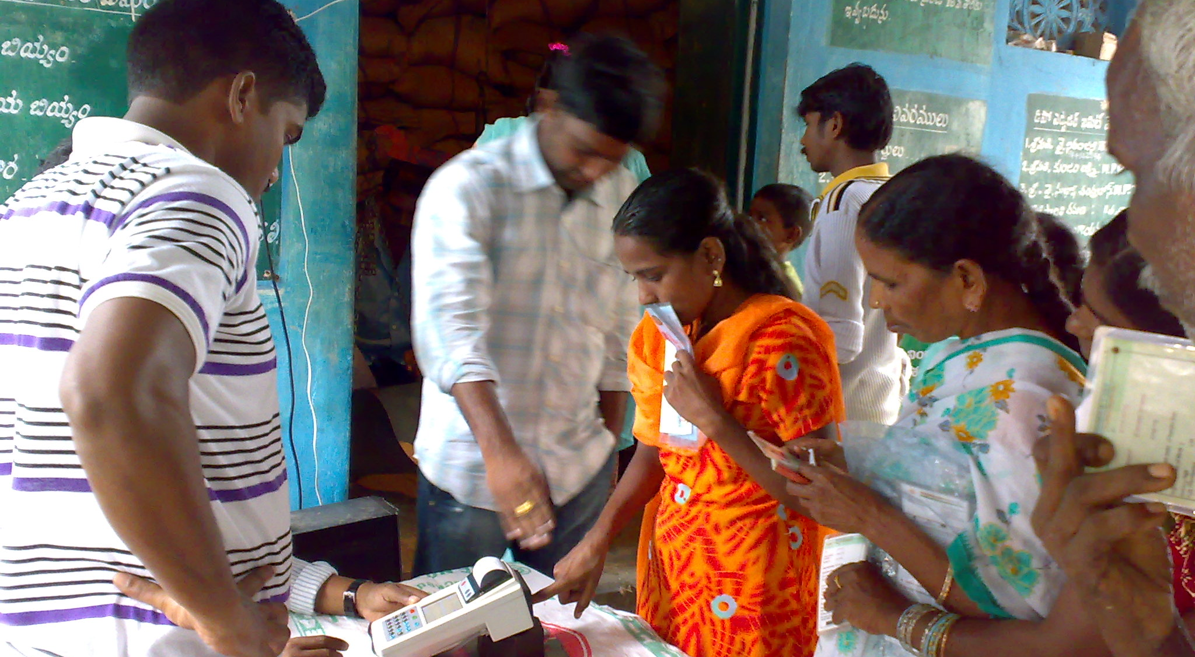
PDS delivery based on Aadhaar Authentication in East Godavari, Andhra Pradesh

Slide 24
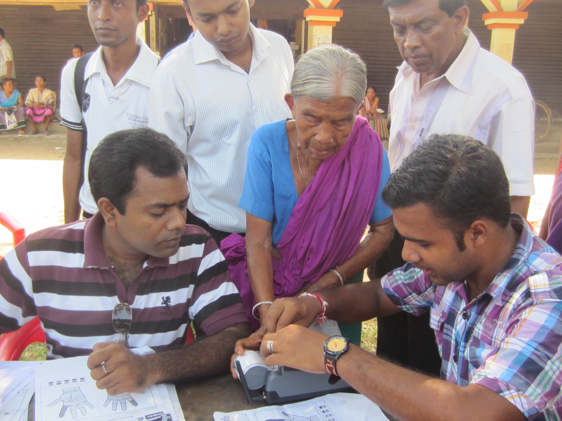
Old age pension payment in Tripura

Slide 25
Empowerment, Choice and Convenience
Identity
Unique identity to every resident of India which is nationally valid – especially useful for those who have no identity
Mobility
Aadhaar recognizes that the Indian resident is mobile and migrant. Aadhaar enrollment because of its unique de-duplication capability can be done anytime anywhere.
Aadhaar authentication because of its on-line nature can also be verified anytime, anywhere.
Gateway to Services
As Aadhaar becomes a KYC (or POI and POA) for a whole range of products and services (bank accounts, mobile connections, LPG connections, state Govt. services, insurance, etc), just possession of an Aadhaar number opens more and more doors.

Slide 26
Convenience
Availability of e-services, multiple assisted agent points (BCs, CSC, Post Office etc) along with self-service make access to public services far more convenient, at your doorstep or cell phone, and many of these services will be available 24x7.
Transaction authentication
On-line real time transaction authentication ensures that the entitlements and benefits go to the truly deserving.
Entitlement portability
Agent interoperability which enables a resident to withdraw his money from any BC, or a networked PDS which allows rations from any ration shop has two benefits.

Slide 27
Open access
Access to services can be based on simple, transparent non-discretionary rules making it easy for the deserving to get in.
Non-repudiation
Because an Aadhaar transaction is fully audited and has non-repudiation, it allows the resident to make his claim and prove that his entitlement has been provided or not
Self-service
Aadhaar authentication can work equally well in an ‘assisted agent’ transaction as in a self-service transaction (on one’s own mobile device). This seamlessness will make a easy transition as more and more services become ‘self-service’ as people become more literate, have their own cell phones etc.

Slide 28

Social Inclusion is Possible
Digital Identity
Local Language Content
Credit Registries
Digital / Online Payment
Mobile Commerce
Insurance, banking
Govt. Services
Social Networks
Aadhaar identity platform and Aadhaar enabled applications
can help a billion people
to participate
in digital economy
and avail services tailored their needs.

Slide 29
Thank You

